Slide 1
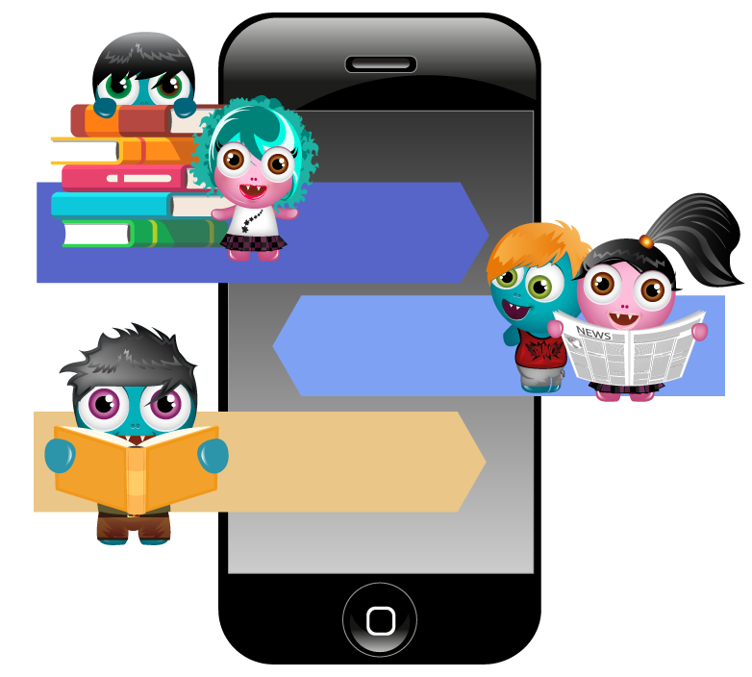

Using
the app

Slide 2
Connecting your child’s account

Slide 3
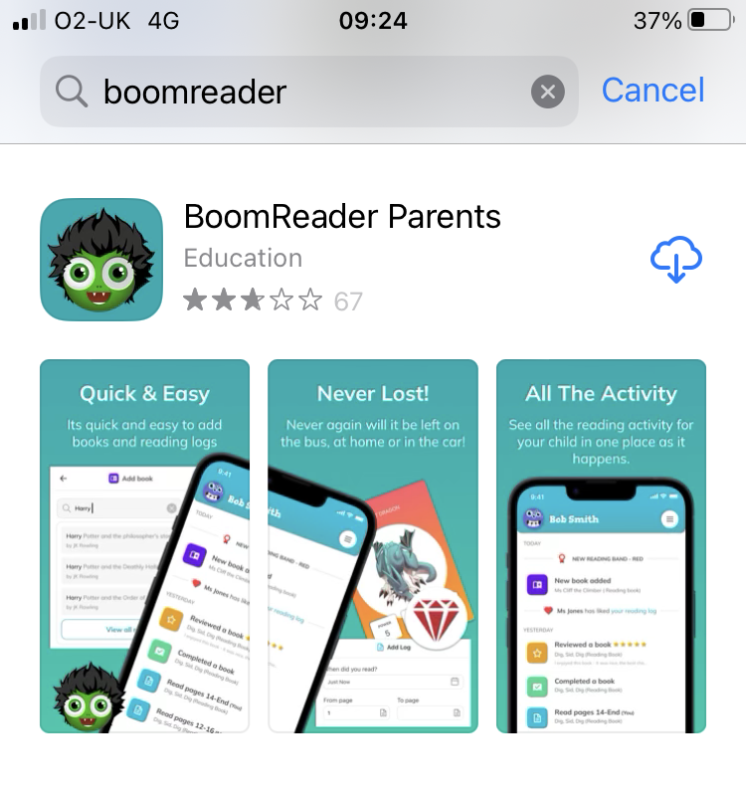


First download the BoomReader app to your phone.
The app is available on the Apple App Store or Google Play
Search: BoomReader Parents

Slide 4
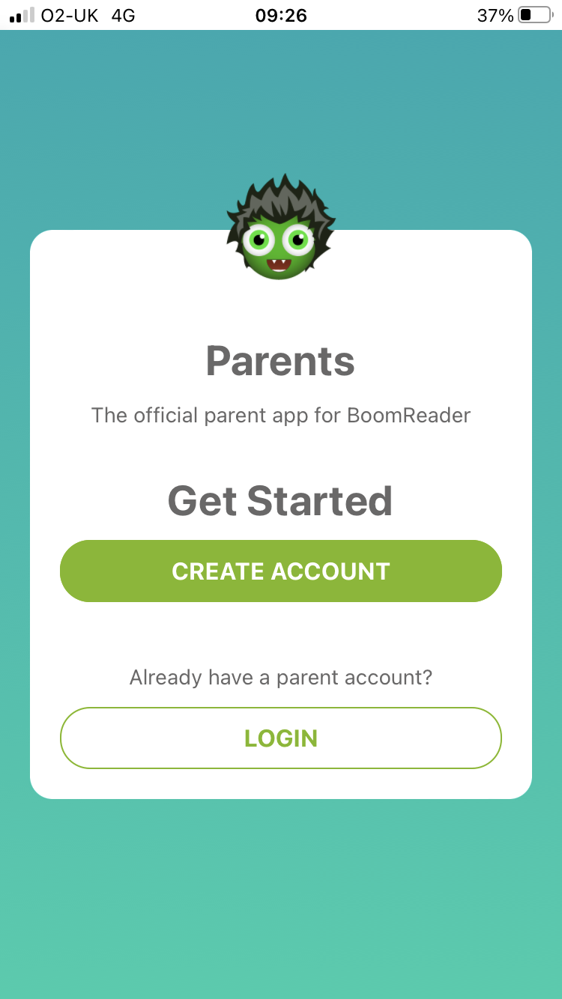
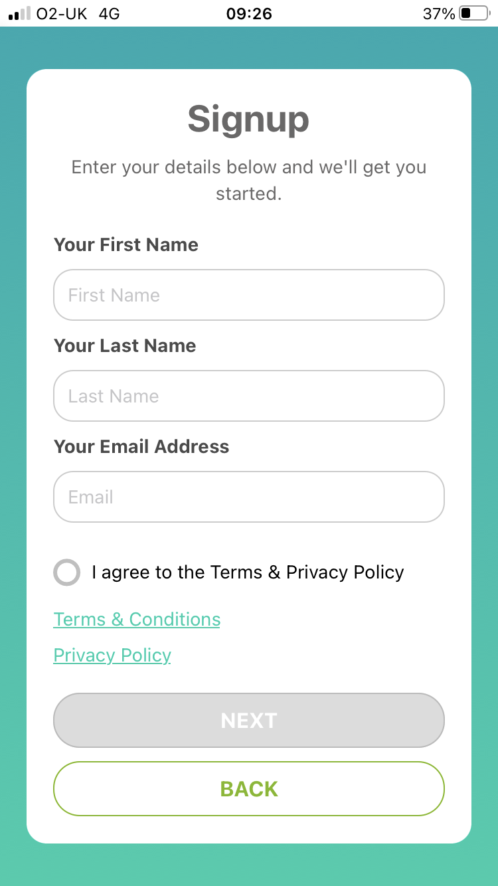
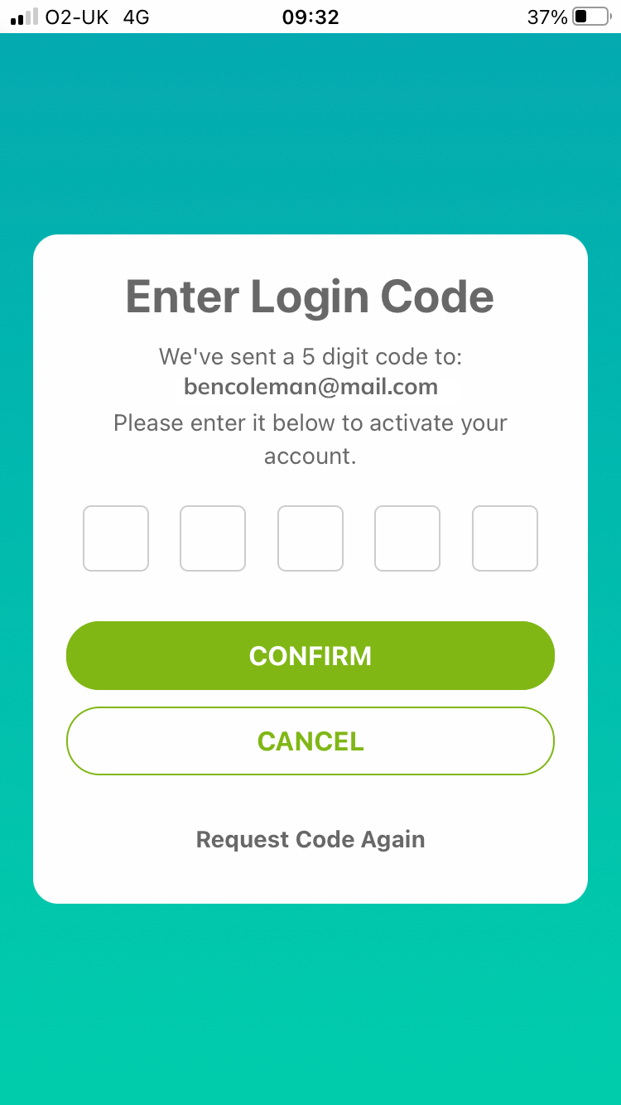
You’ll first need to create your parent account.
BoomReader will email you a 5 digit login code.
Enter it to activate your account and login.

Slide 5
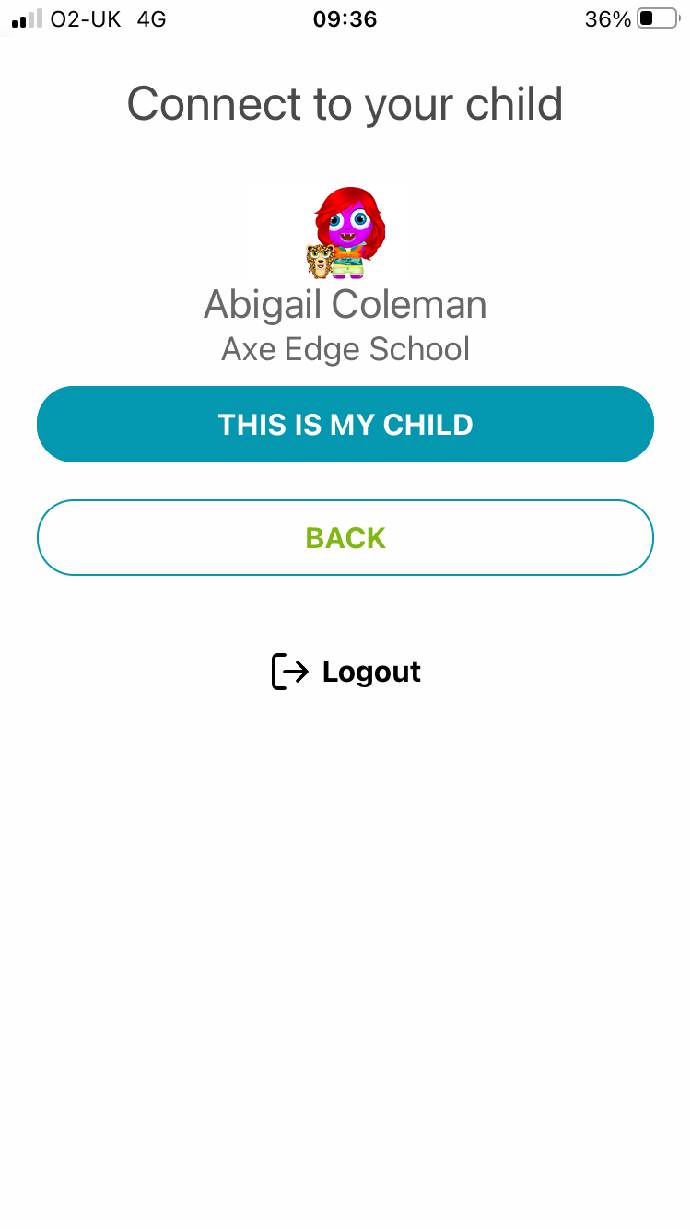
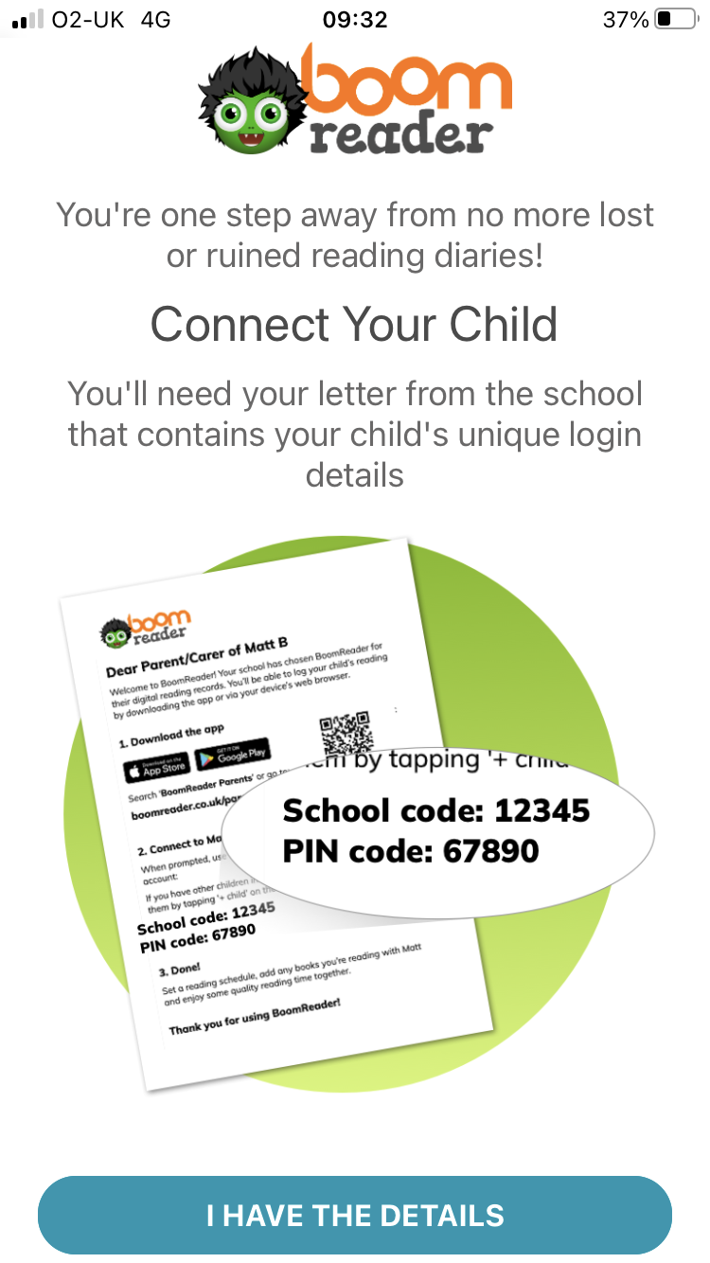
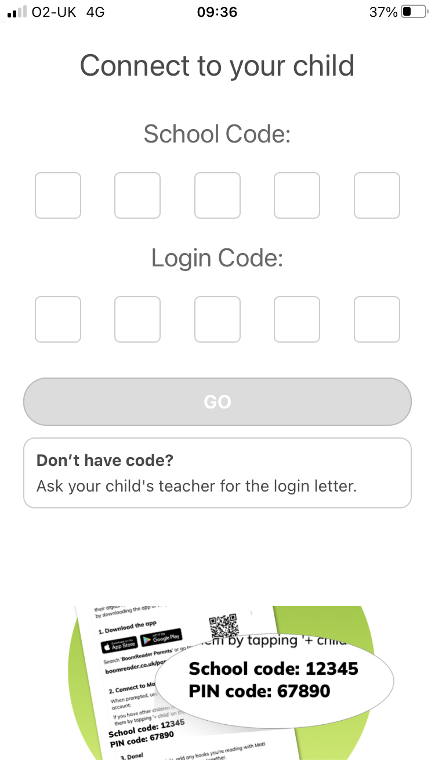
Next you need to connect to your child’s account.
Use the details on the letter that your school sent you.

Slide 6
What’s in the app?

Slide 7
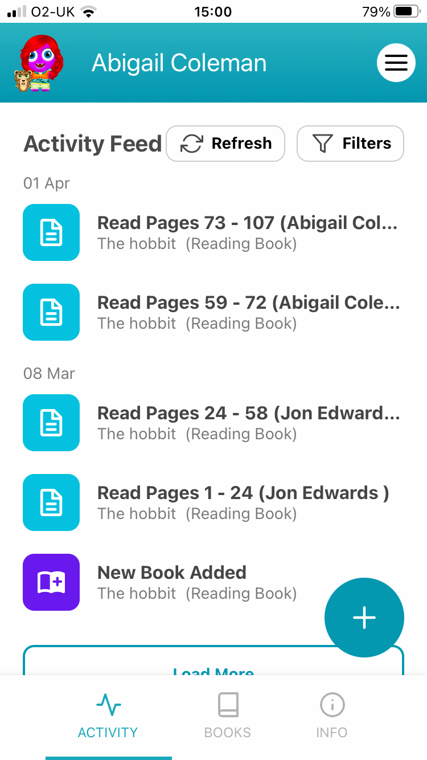
Your child’s activity feed shows you a timeline of the reading activity.
It shows all logged reads, books added and changes to reading bands in date order.
Tap an activity to see more details.

Slide 8
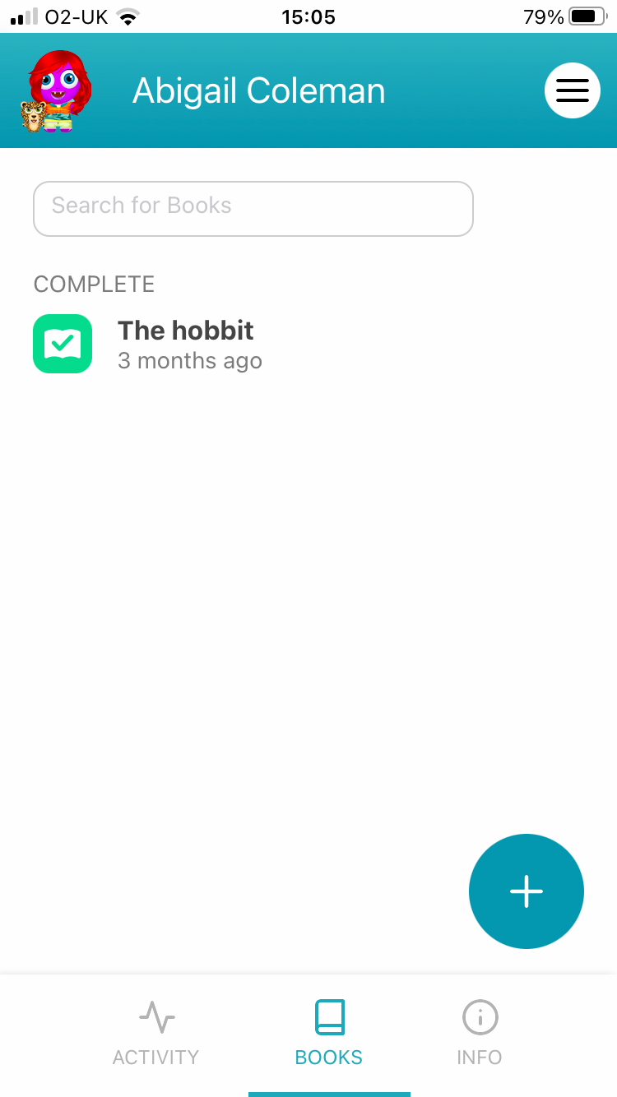
The books tab shows you all your child’s books including those they are currently reading.
Tap each one to see the complete reading logs and other details for that book.

Slide 9
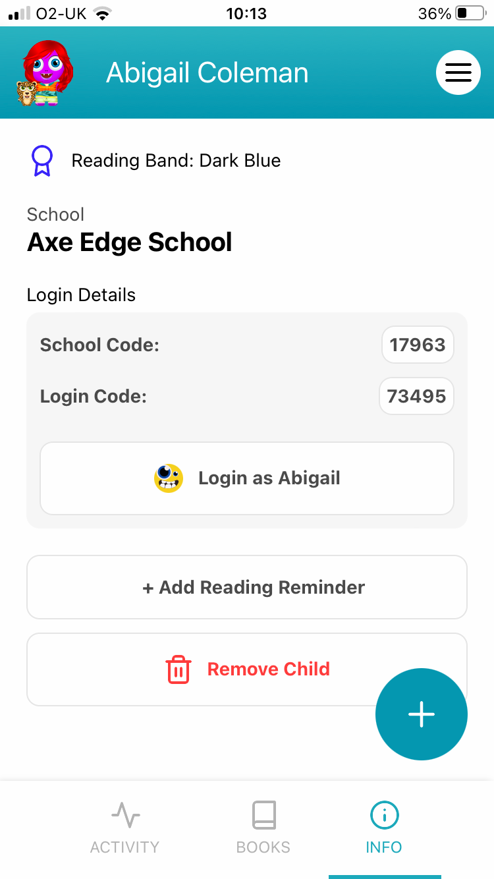
The info tab shows your child’s details:
School
Current reading band
Login details

Slide 10
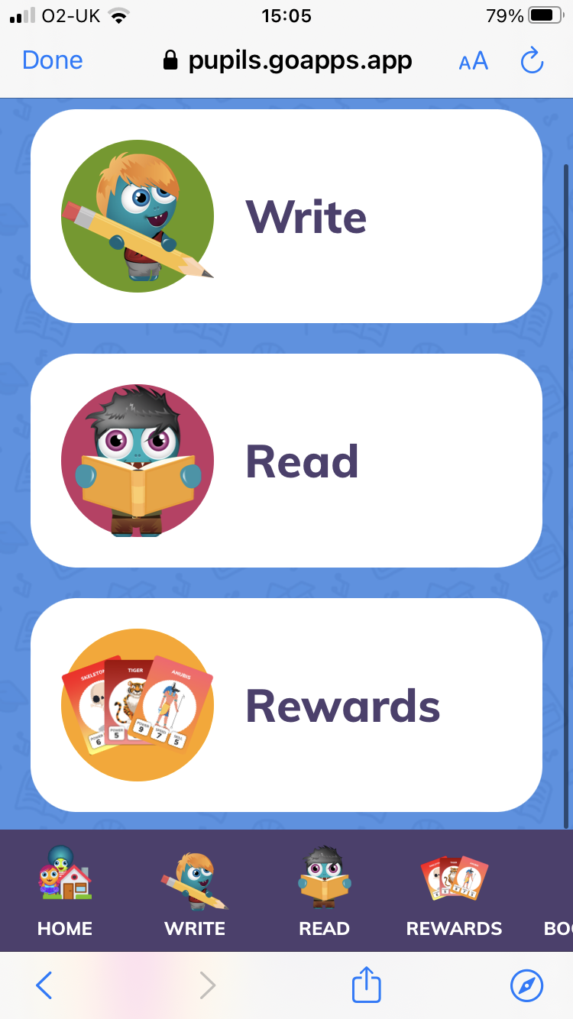
You can log in as your child and help them ‘spend’ their Gems, style their Boomer character or even let them record their own reading.

Slide 11
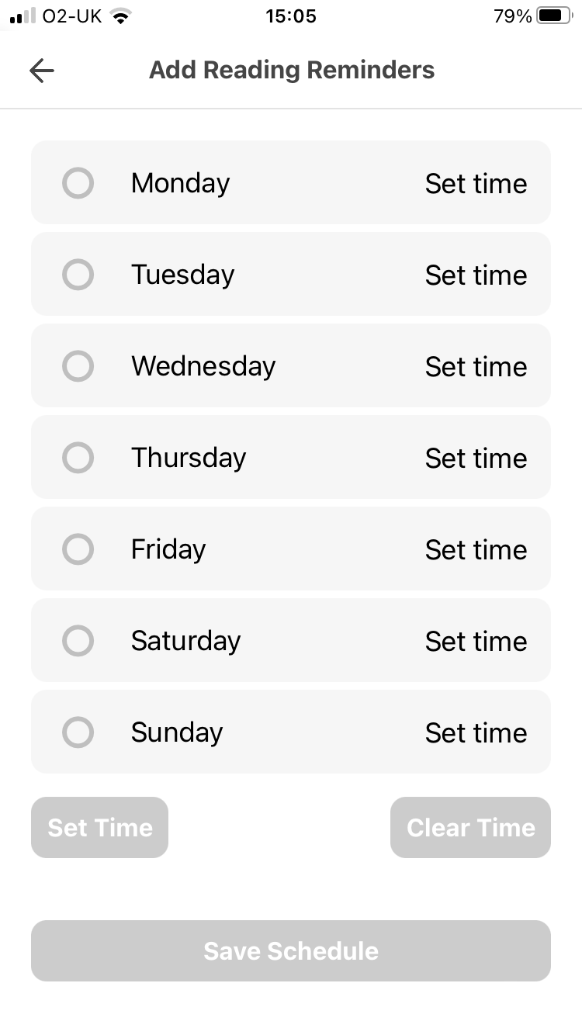
To help you set aside regular reading time you can create reminders to read at home.

Slide 12
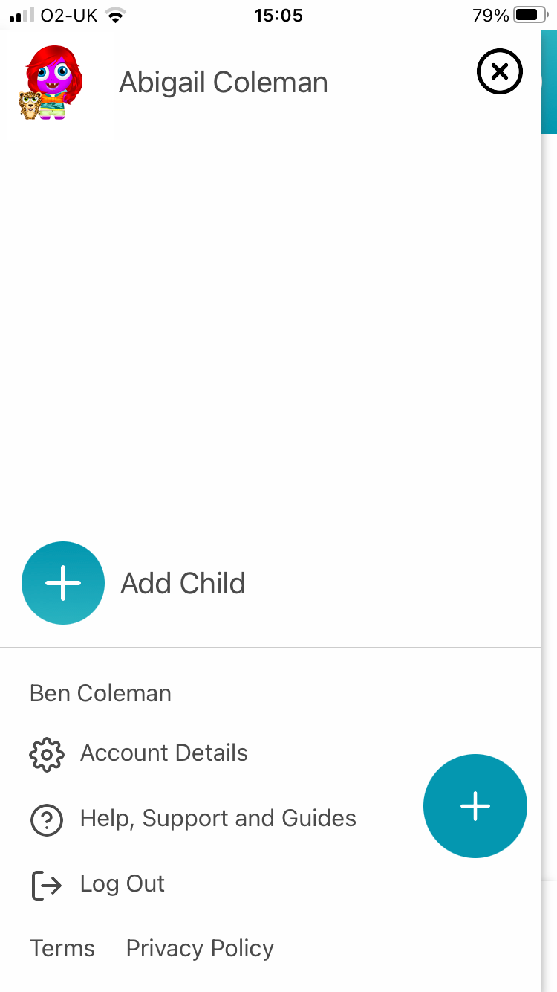
The menu lets you:
Add more children
Edit account details
View help guides

Slide 13
Adding a book

Slide 14
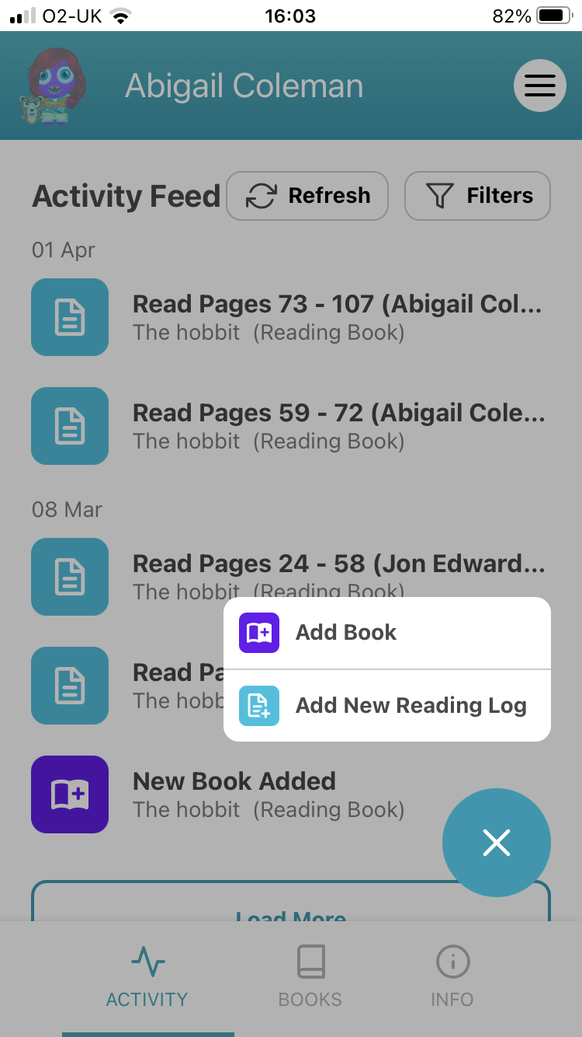
If your child’s book isn’t already added it’s easy to do so.
Click the + button and select ‘Add Book.’

Slide 15
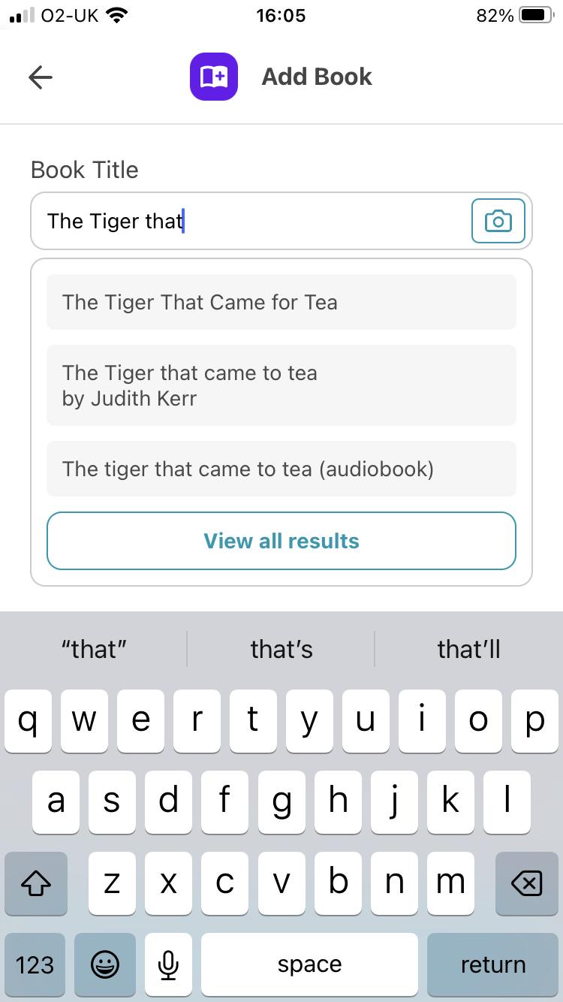
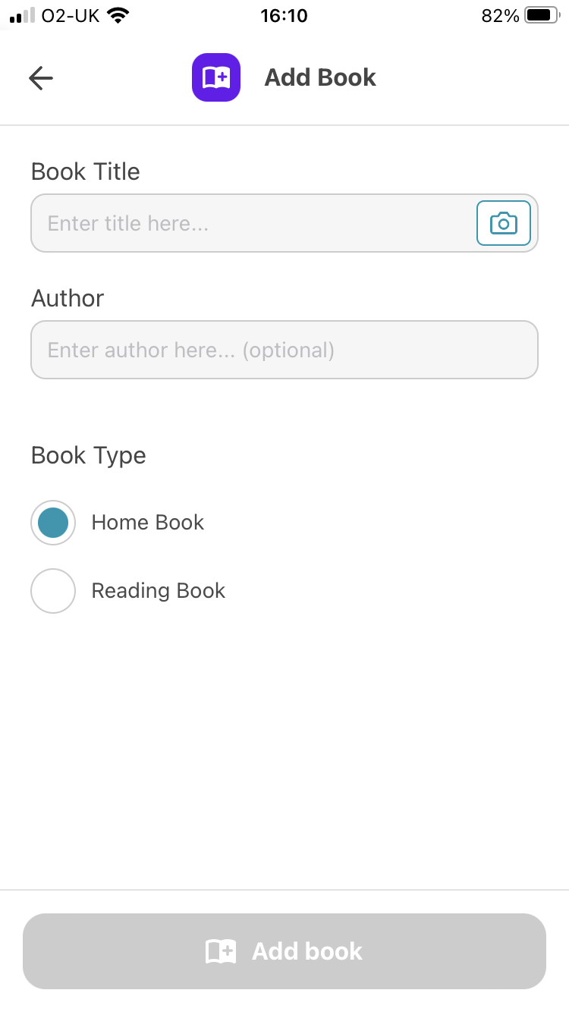
To add a book, start typing the name of the book. We will suggest books from our database.
No matches? Just type the full title and we’ll add it to our library!

Slide 16
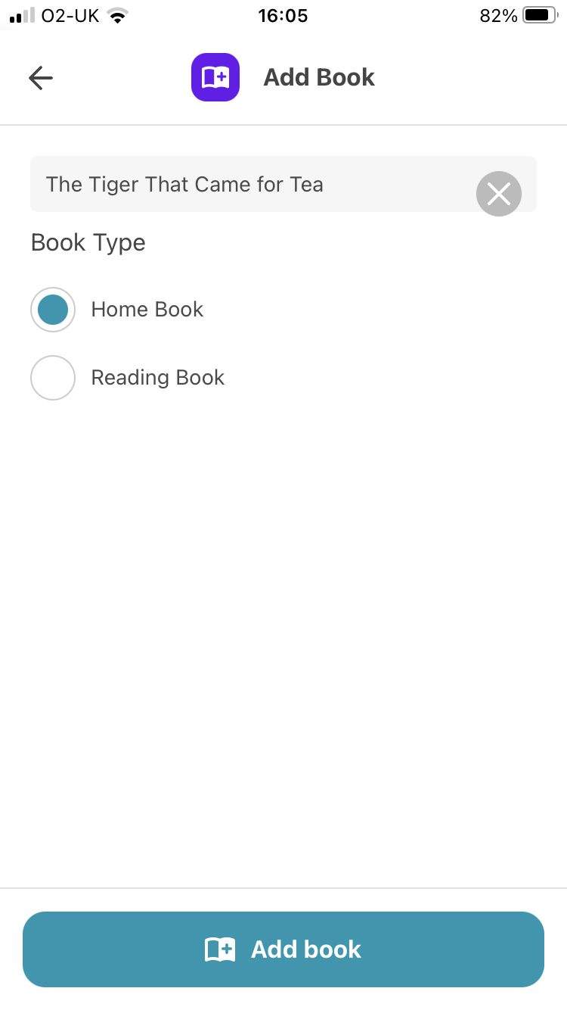
Next, select if it is a home book or a class reading book.
A home book is generally one you own yourself.
A reading book is a book your child has brought home from school.

Slide 17
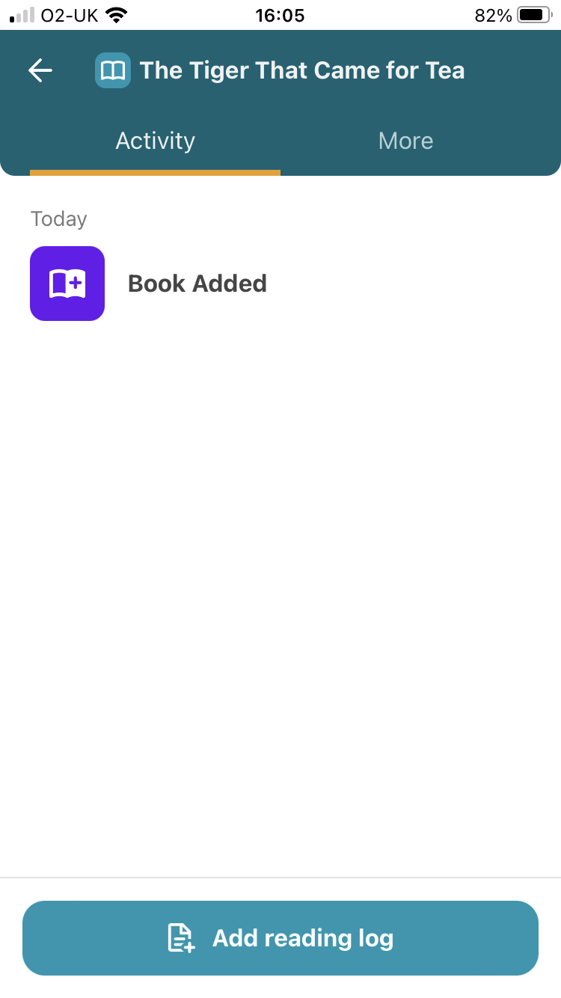
The book has now been assigned to your child.
You can add a reading log straight away by tapping the Add reading log button.

Slide 18
Adding a reading log

Slide 19
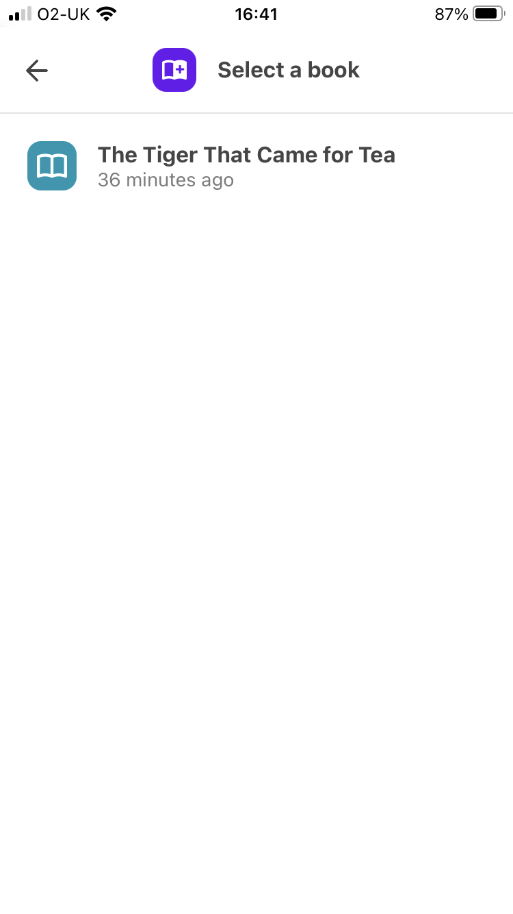
To add a reading log:
Tap the + button
Add New Reading Log
Select the correct book

Slide 20
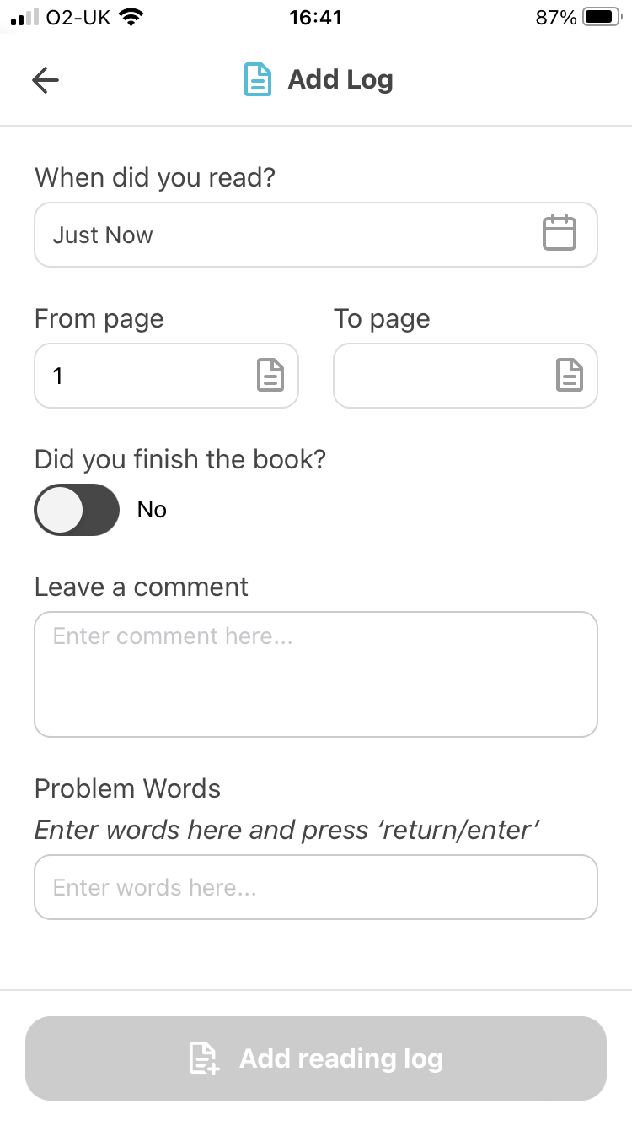
To add a log you just need to enter the page numbers.
Once you enter a ‘To page’ you’ll be able to add the reading log.
1
2

Slide 21
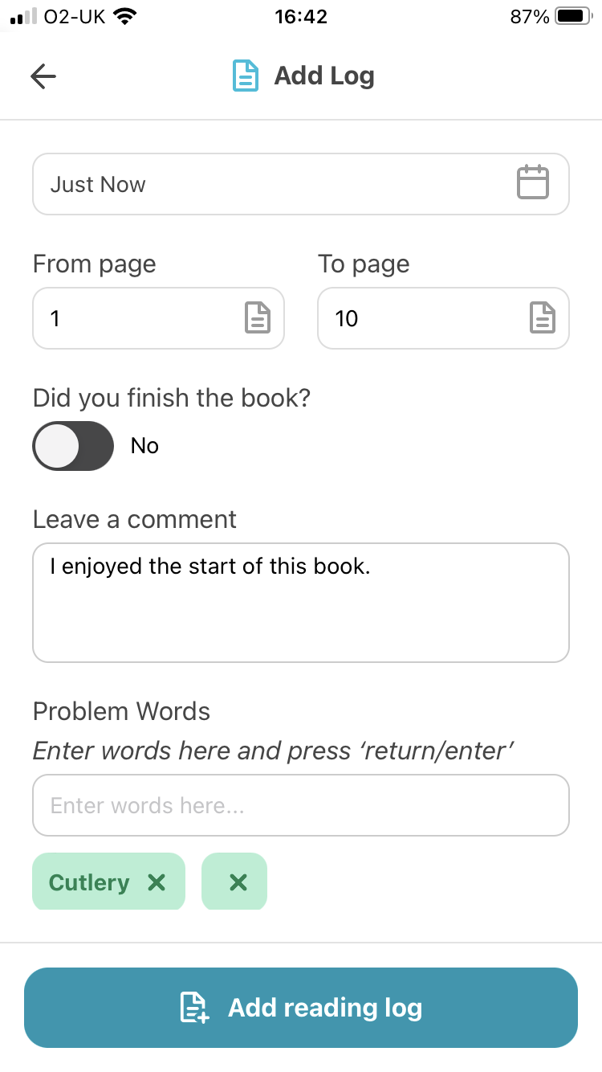
If you are able to comment on how your child has read it will support your child’s teacher in accurately assessing your child’s attitude to reading outside of school.
You can add a short comment and highlight any specific words or sounds your child struggled with.

Slide 22
If you’ve finished the book in this reading session, just tap the slider and when you add the log we’ll mark it as completed.

Slide 23
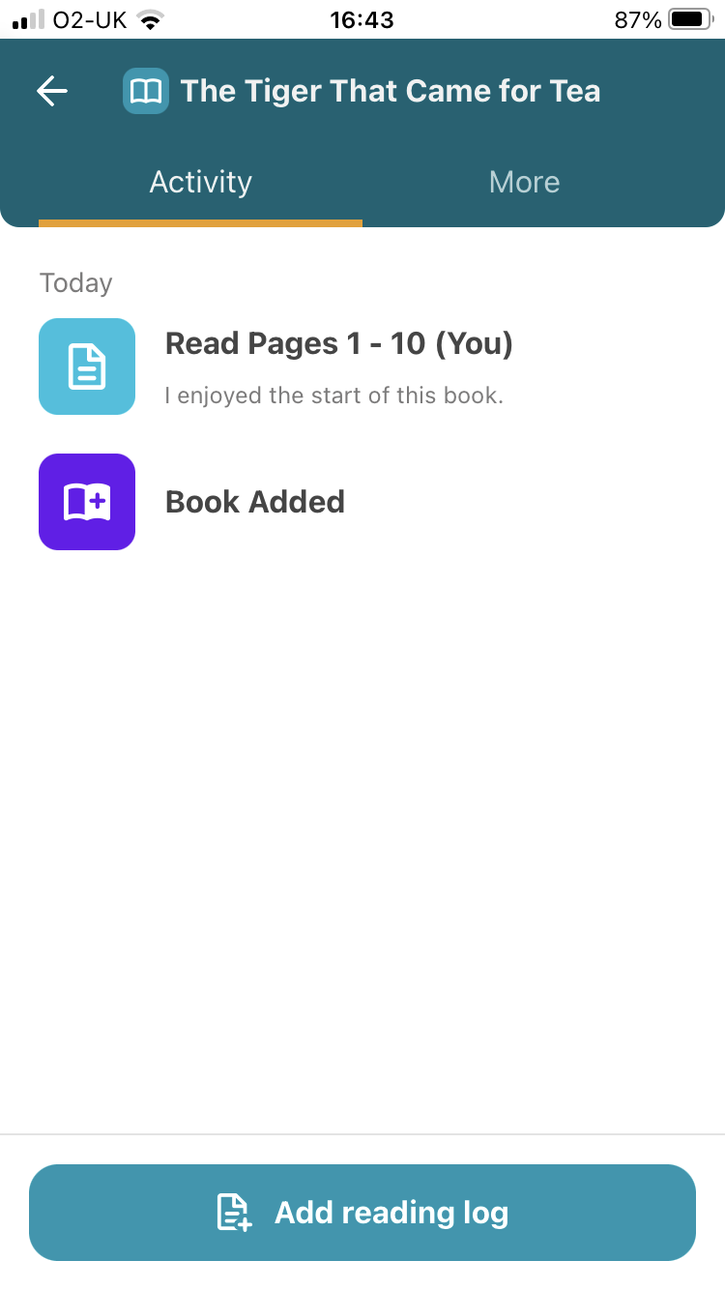
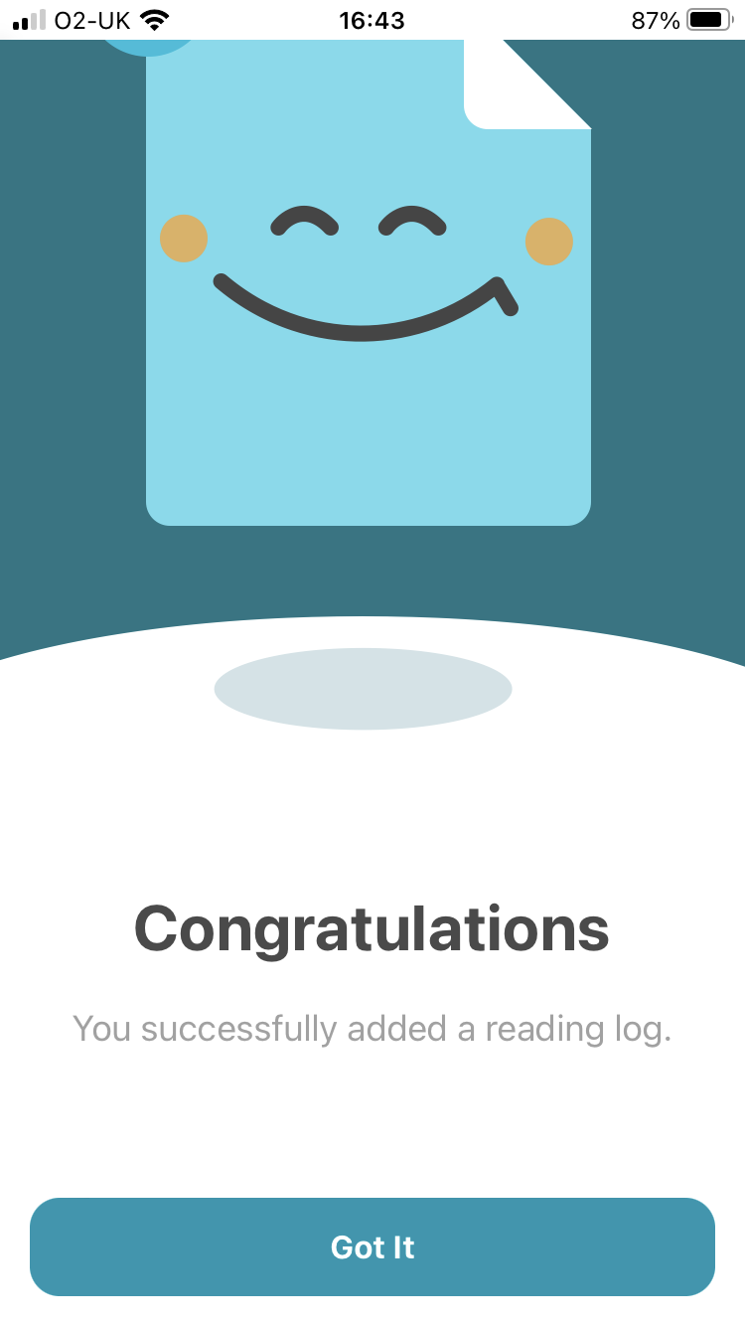
That’s it… You’ve added your first reading log.
You can always view and edit your log just by tapping it from the activity feed.

Slide 24
Re-read book

Slide 25
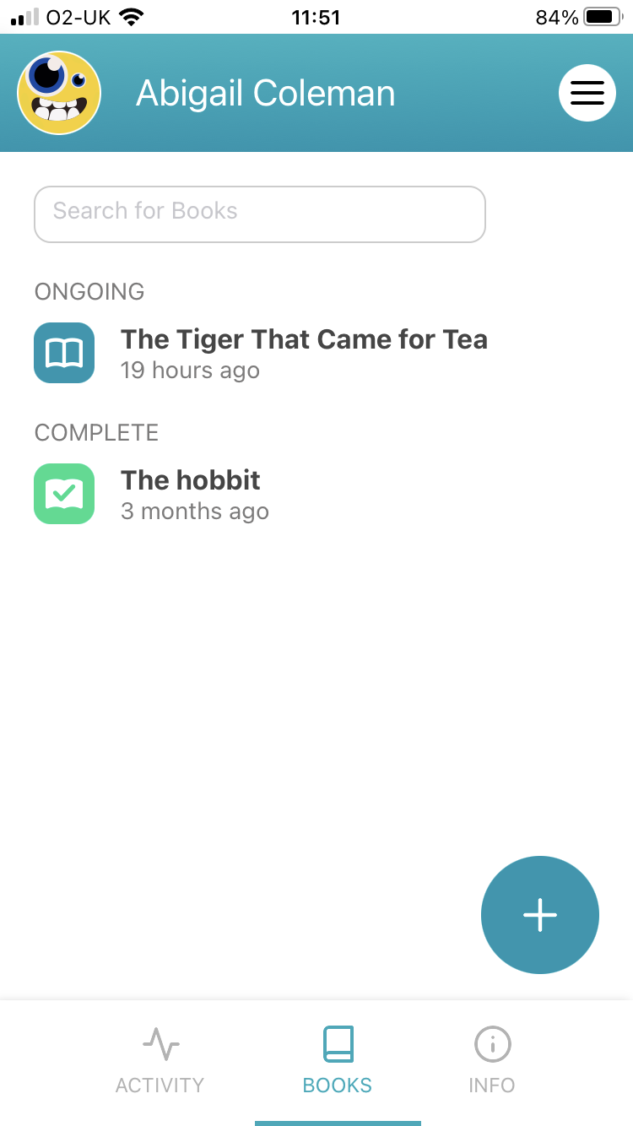
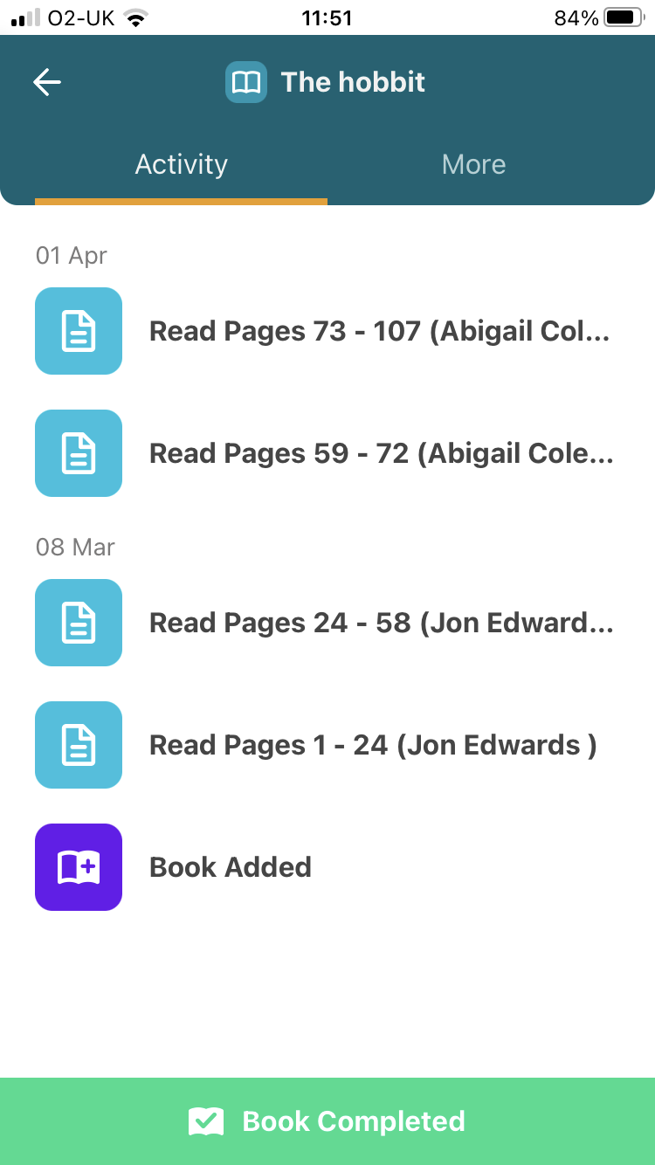
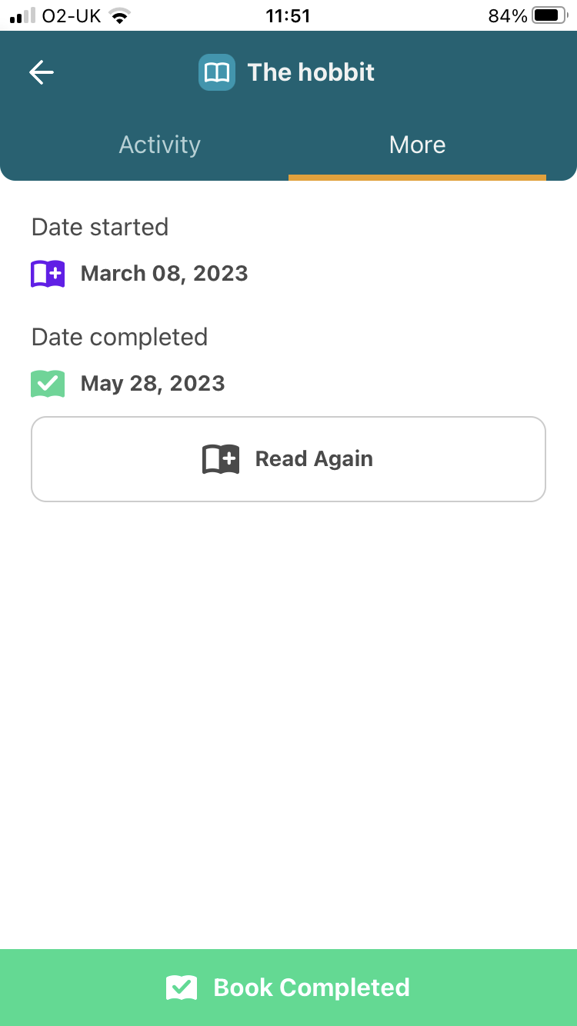
If you need to re-read the book several times, use the ‘Read Again’ button to quickly re-assign the book.

